Slide 1
Retail Giant Sales Forecasting Assignment
Saptarshi Saikia

Slide 2
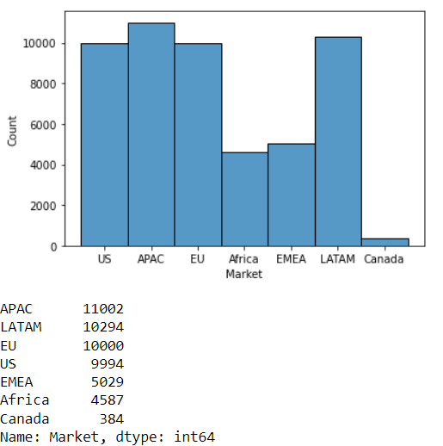
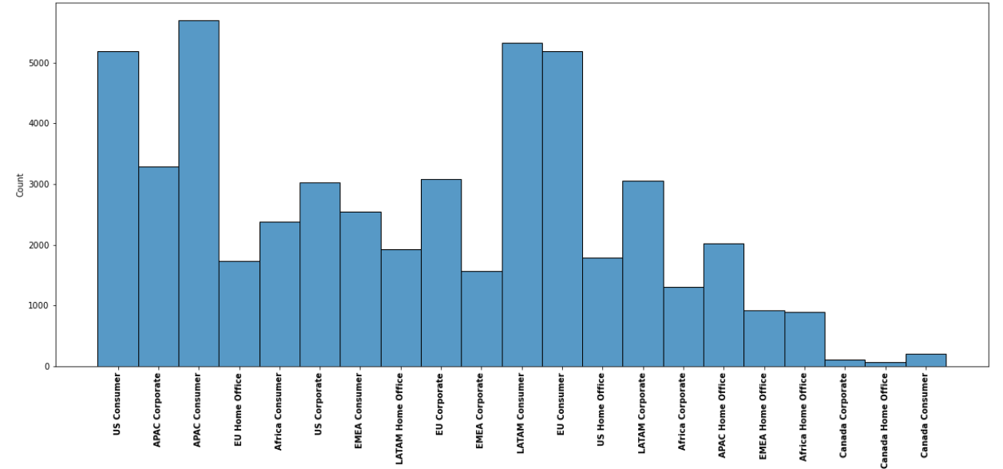
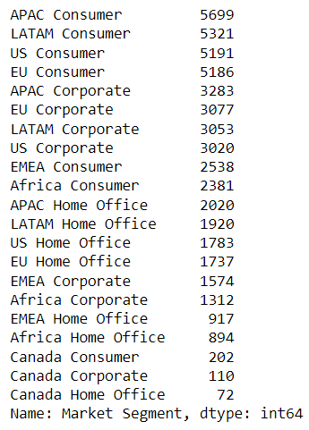
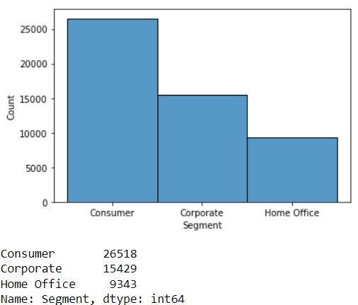
Counts of all the Markets, Segments and Market Segments in the data set
APAC seems to have the highest count among markets followed by LATAM and EU
Consumer has the most counts followed by Corporate and Home office in the segments section
Among the market segments APAC Consumer is the most popular followed by LATAM Consumer and US Consumer.

Slide 3
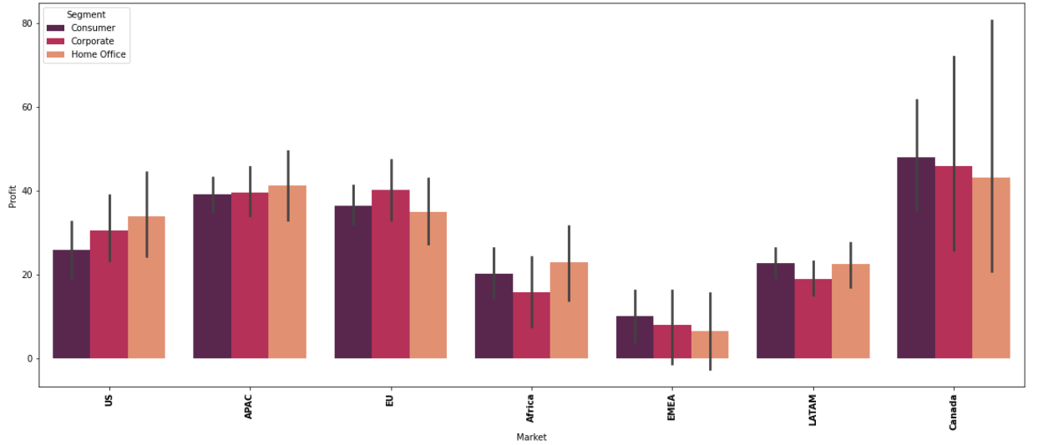
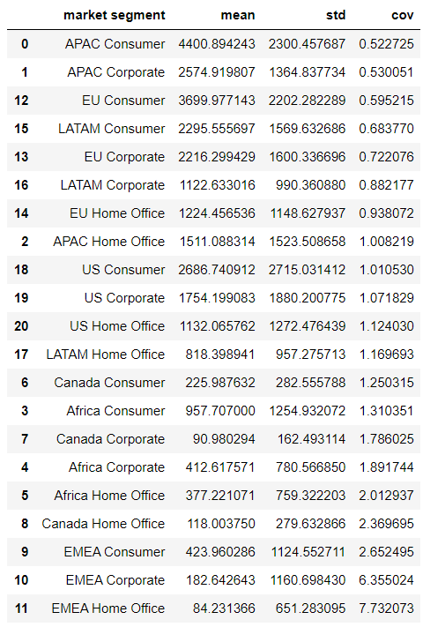
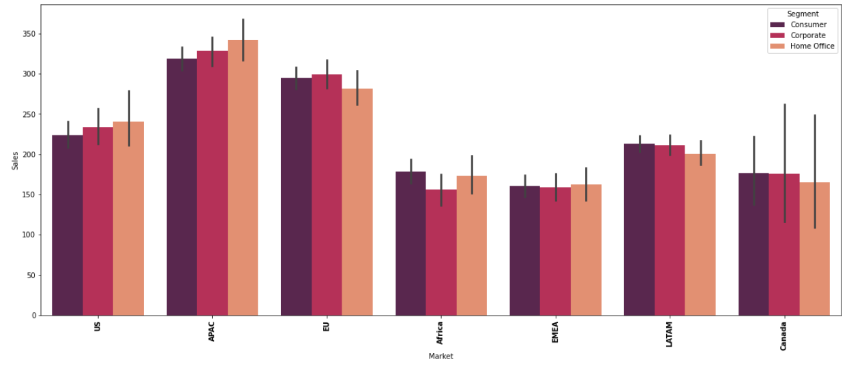
Coefficient Of Variance across all Market Segments
Profit across all market segments
Canada has the most profit followed by APAC
APAC has the highest sales followed by EU
APAC Consumer has the lowest Coefficient of Variance among all market segments so it’s the most profitable market segment.
Sales across all market segments

Slide 4
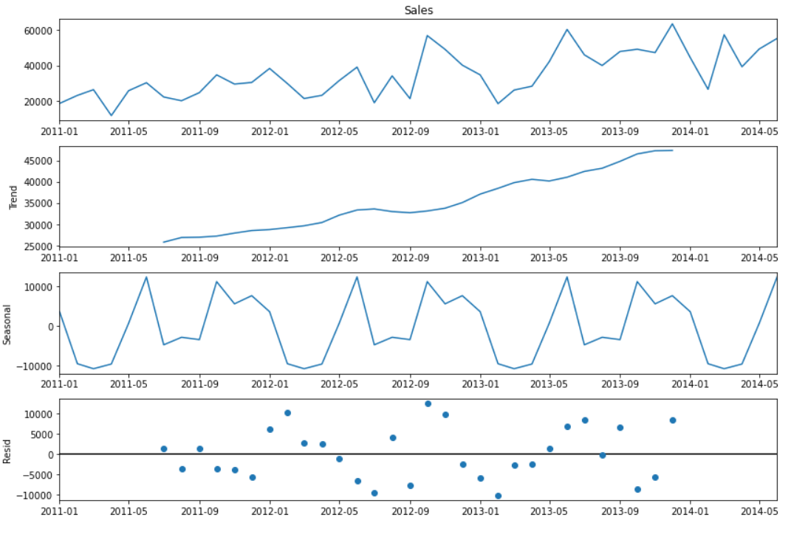
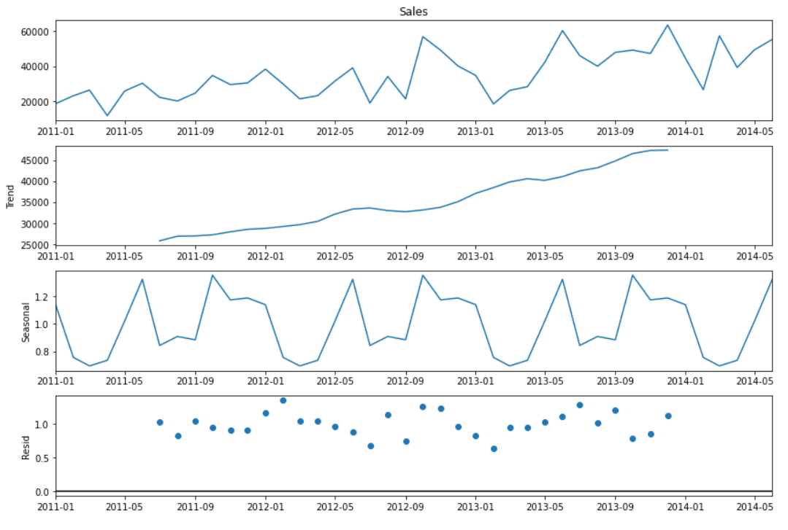
Additive Seasonal Decomposition
Multiplicative Seasonal Decomposition
Decomposition was done to reduce the time series plot into its components of trend, seasonality and residuels

Slide 5
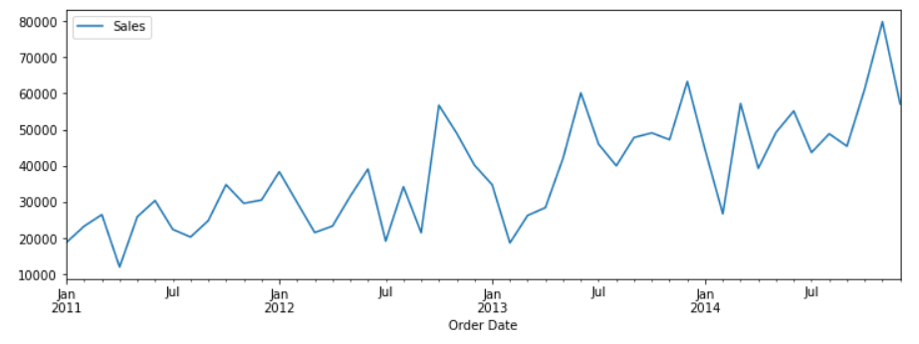
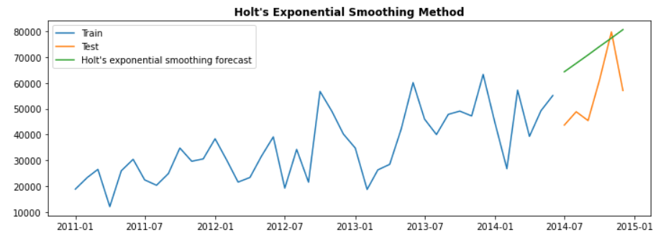
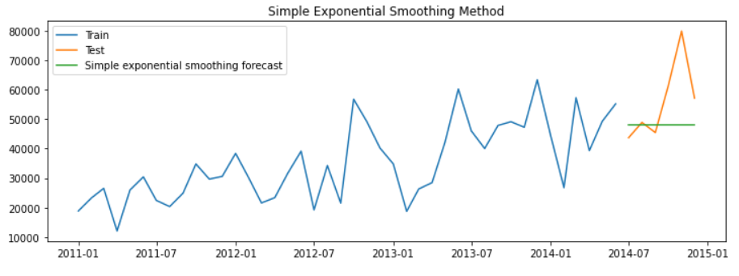
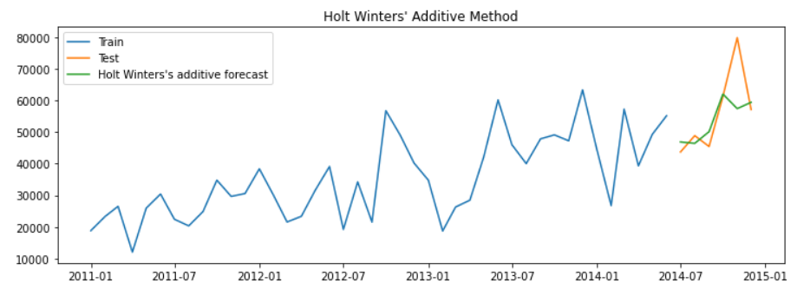
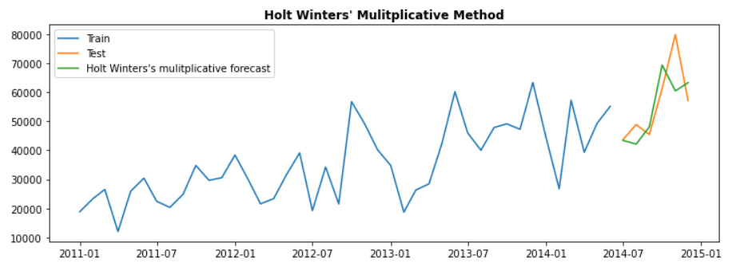
Original Sales data vs. Smoothing Technique Methods
Original Data
Here we can see the original time series data in blue and then the test data in orange. The green line represents the forecast predicted by each method. Of all the forecasts predicted we can see that Holt Winters’ multiplicative method matches the test data the closest.

Slide 6
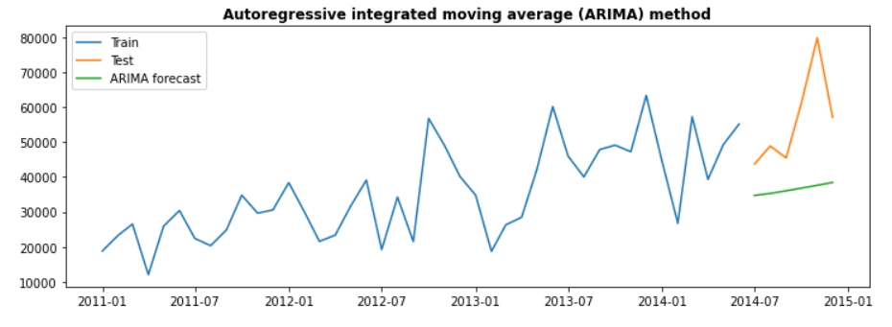
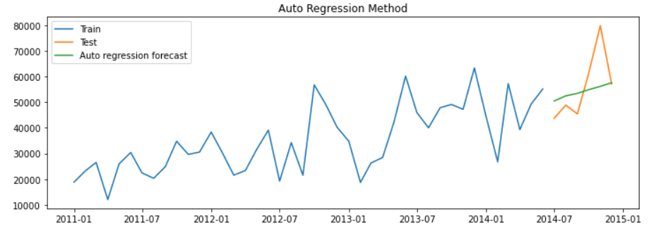
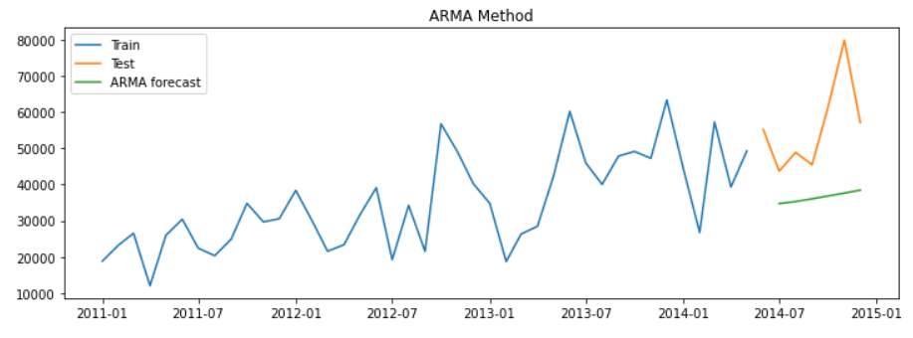
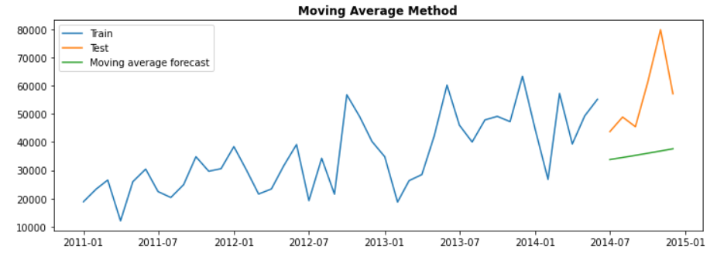
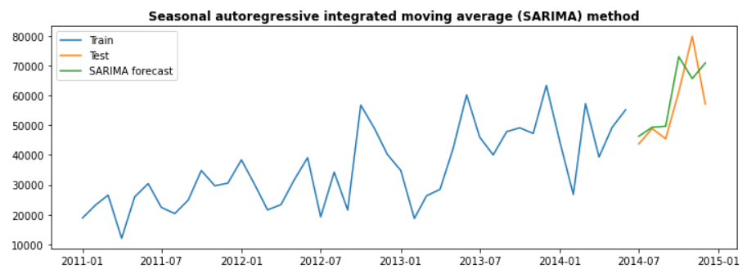
Original Sales data vs. ARIMA Methods
Original Data
Of all the ARIMA set of methods we can see that the SARIMA method plot is the closest to the test set of the data

Slide 7
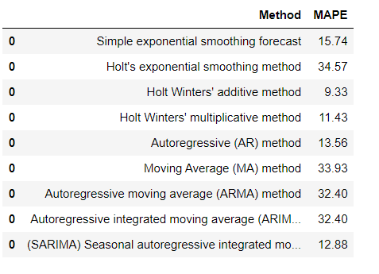
Mean Absolute Percentage Error of each method conducted
After doing all the techniques we can see that Holt Winters' additive method is the best forecasting method in the smoothing technique.
Among the ARIMA set of techniques we can see that SARIMA is the best method.

Slide 8
Thank You

